Slide 1
FINAL YEAR PROJECT PROPOSAL 2014 GROUP 01
Department of Information Technology
College of Science and Technology
Royal University of Bhutan

Slide 2
Title: Student Management System
Project Guide: Mr. Tshering
Group Members:
Dechen Wangmo
Sonam Namgyel
Sonam Tobgay
Tshewang Rinzin

Slide 3
Presentation Outline
Introduction
Background & Literature Review
Motivation
Project Scope
Objectives
Methodology
System Architecture
Work Plan
Expected Outcome
Conclusion
Future Enhancement

Slide 4
Introduction
Student Management System (SMS):
is a system that can manage the records of student regarding admission, result, events, hostel, health, fees payment,.. etc
SMS can consist the following components:
Student Information System
Result Management System
Hostel Management System
Event Management System
Library Management System, etc

Slide 5
Background & Literature Review
Presently, traditional means of paper, ms excel, ms access are used to manage students’ information and results.
Information management becomes handy with the increasing number of students yearly
Thus, there need a systematic software/program to manage and maintain student information.
This project will develop the software solution that can manage all data with reduced human resources. It can provide easy, accurate, unambiguous and faster data access.

Slide 6
Motivation
To meet a solution to manage students records in the College of Science and Technology
To overcome the existing problems occurring in maintenance of students information
To develop software development skills through this real time project implementation.

Slide 7
Scope of the Project
To manage records of student regarding admission/registration and examination result.
Project phases include:
Student Information System involves:
Student admission/registration
Student details
Fee payment records
Student ID generation

Slide 8
Scope of the Project(2)
II. Result Management System:
Continuous assessment
Attendance report
Previous academic records
Semester module subscription
Student’s quota validation
Publish / unpublish student results
View results

Slide 9
Objectives
To manage students information during admission/registration and examination
Efficient utilization of human resources
To reduce unnecessary paper work in maintaining student’s information

Slide 10
Methodology

Slide 11
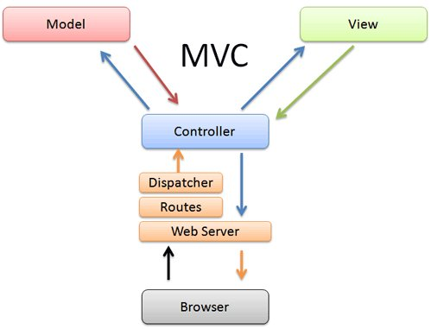
System Architecture
Database

Slide 12
Work plan

Slide 13
Expected Outcome
Student Information System
Result Management System

Slide 14
Conclusion
Helpful to perform paperless work and manage all data
Provides easy, accurate, unambiguous and faster data access
Different reports and Queries can be generated based on options related to students, batch, course, quota, semesters, etc and even for the entire college.

Slide 15
Future Enhancement
This project can be integrated with other institutes under RUB
Other possible modules can also be extended:
Lab Management
Hostel Management
Event Management
Fees Payment Record
Health Records Management

